Slide 1


Ironhack
Final Project
Airbnb Price Prediction App
Carlos Rodríguez Vidondo
Data Science & Machine Learning Bootcamp 08/11/2024

Slide 2
PROJECT OVERVIEW
Goal: Build a predictive model to estimate the price of an Airbnb listing based on its features.
Dataset selection: 'Madrid Airbnb Data', by Murray Cox, from Kaggle.
https://www.kaggle.com/datasets/rusiano/madrid-airbnb-data/data
7 files
107 columns
+ 1.000.000 data points
Data merging:
Multiple datasets were merged into one by using joins.
From the total 100 columns only 16 were essential for the project and were selected.
Columns were renamed for easy management.
Data Science | Machine Learning

Slide 3
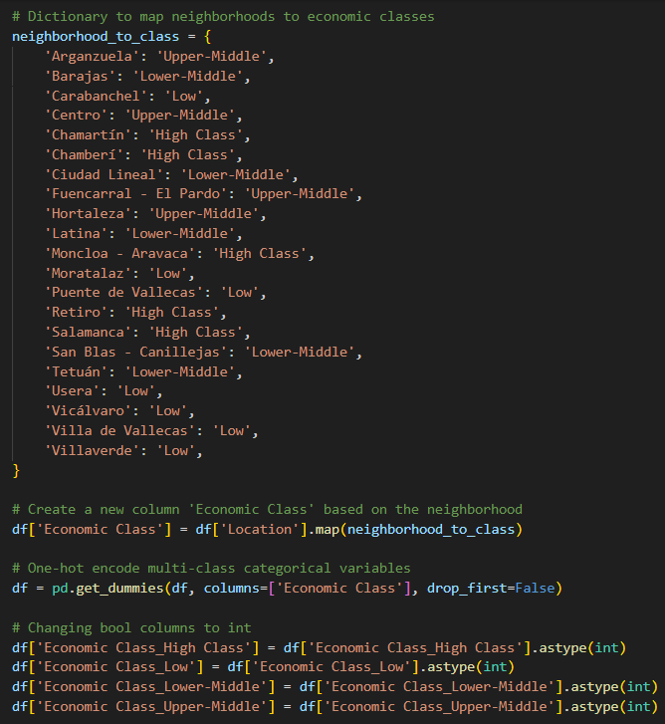
DATA CLEANING
Rows with NaN values in 'Superhost' column were dropped.
Missing values in numerical columns were handled by using imputation strategies (filling with the median).
Binary categorical variables (True/False) were converted to numeric formats using label encoding ('Superhost', 'Available').
Multi-class categorical columns ('Room Type', 'Location') were converted into numerical using One-Hot Encoding and new columns were displayed.
Created binary columns for specific high-value amenities that will upgrade the price for the AirBnb.
Data Science | Machine Learning

Slide 4
EXPLORATORY DATA ANALYSIS
In Python…
Outliers in 'Price' column were removed by using the IQR method.
Checked distributions and visualized relationships between key features and the target variable.
Used correlation matrices, scatter plots and histograms to understand distributions.
Let’s have a look to the Tableau Dashboard…
https://public.tableau.com/app/profile/carlos.rodr.guez.vidondo/viz/AirbnbFinalProject-Carlos/Dashboard1
Data Science | Machine Learning

Slide 5
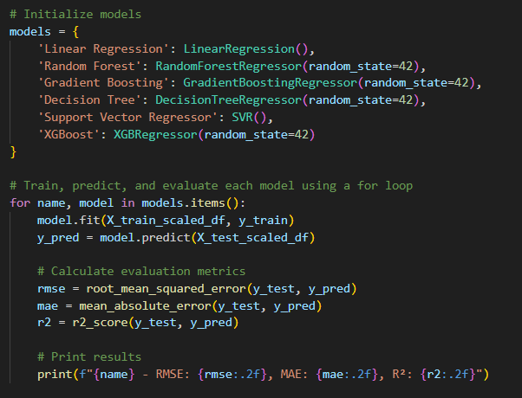
MACHINE LEARNING
— Feature Engineering: Selected relevant numerical columns for scaling and applied StandardScaler to standardize their values. (saved into a pickle file)
— Model selection: Trained multiple regression models, including Linear Regression, Random Forest, Gradient Boosting, Decision Tree, Support Vector Regressor and XGBoost.
— Evaluation: Using metrics like RMSE, MAE, and R².
Data Science | Machine Learning

Slide 6
BEST MODEL?
MODEL | RMSE | MAE | R2
Linear Regression | 30.01 | 21.55 | 0.43
Random Forest | 30.26 | 21.46 | 0.42
Gradient Boosting | 28.69 | 20.50 | 0.48
Decision Tree | 37.69 | 26.32 | 0.10
Support Vector Regressor | 30.27 | 20.23 | 0.42
XGBoost | 28.98 | 20.74 | 0.47
Hyperparameter tuning on both models showed better performance on XGBoost
Data Science | Machine Learning

Slide 7
MODEL DEPLOYMENT
Streamlit App:
Collects inputs such as location, capacity, room type, and various amenities from the user via a sidebar interface.
Displays images of the selected neighborhood to provide additional context for the user.
Predicts the nightly price based on the user inputs and displays the result.

